Slide 1
Computer Systems, Data Structures & Data Management
Markos Vassilis Mediterranean College, Spring 2024-2025
Week 18

Slide 2
O(n) Revisited

Slide 3
Warm up
Right or wrong?
f(n) = n^2 + 6 * n is O(n).
Wrong!
f(n) = n^2 + 6 * n is O(n^2).
Right!
f(n) = n^2 + 6 * n is O(n^4).
Right!
f(n) = n^2 + 6 * n is O(2^n).
Right!
f(n) = n^2 + 6 * n is O(log(n)).
Wrong!

Slide 4
(Reminder) A rule of thumb
Some of the most popular complexity classes, ordered in increasing complexity (i.e., every function f(n) is O(g(n)) for any g(n) below f(n)):
f(n) = 1
f(n) = log(n)
f(n) = sqrt(n)
f(n) = n
f(n) = nlog(n)
f(n) = n^2
f(n) = n^3
f(n) = 2^n
f(n) = n!
f(n) = n^n

Slide 5
Exercise
What is the (asymptotic) worst-case computational complexity of the following algorithm for an input list, a, of size n?
for each x in a: if x is odd: print(“Odd”) else: print(“Even”)
Answer: O(n), since we access each of its elements just once.

Slide 6
Exercise
What is the (asymptotic) worst-case computational complexity of the following algorithm for an input list, a, of size n?
read x from user for each y in a: if x == y: print(“Found!”) return print(“Not found!”) return
Answer: O(n), since we access each of its elements just once in the worst case, which is that the element we have to look for (x) is either last or does not exist in a.

Slide 7
Sorting (Revisited)

Slide 8
Sorting
It is nice to have things in place. Consider the following array:
arr = [3, 6, 1, 7, 9, 0, 2];
Evidently, arr is not sorted in any meaningful way. How can we put thing in increasing order (in a systematic way).
[Take some time to devise a sorting algorithm that can work for arbitrary size arrays, not just for arr.]

Slide 9
Bubbles. I want more bubbles.
3
6
1
7
9
0
2
3 < 6 → Things in place!
3
6
1
7
9
0
2
6 > 1 → Things not in place!
3
1
6
7
9
0
2
1 < 6 → Swap!
3
1
6
7
9
0
2
6 < 7 → Things in place!

Slide 10
Bubbles. I want more bubbles.
3
1
6
7
9
0
2
7 < 9 → Things in place!
3
1
6
7
9
0
2
9 > 0 → Things not in place!
3
1
6
7
0
9
2
0 < 9 → Swap!
3
1
6
7
0
9
2
9 > 2 → Things not in place!

Slide 11
Bubbles. I want more bubbles.
3
1
6
7
0
2
9
2 < 9 → Swap!
3
1
6
7
0
2
9
3 > 1 → Things not in place!
1
3
6
7
0
2
9
1 < 3 → Swap!
1
3
6
7
0
2
9
3 < 6 → Things in place!

Slide 12
Bubbles. I want more bubbles.
1
3
6
7
0
2
9
6 < 7 → Things in place!
1
3
6
7
0
2
9
7 > 0 → Things not in place!
1
3
6
0
7
2
9
0 < 7 → Swap!
1
3
6
0
7
2
9
7 > 2 → Things not in place!

Slide 13
Bubbles. I want more bubbles.
1
3
6
0
2
7
9
2 < 7 → Swap!
1
3
6
0
2
7
9
1 < 3 → Things in place!
1
3
6
0
2
7
9
3 < 6 → Things in place!
1
3
6
0
2
7
9
6 > 0 → Things not in place!

Slide 14
Bubbles. I want more bubbles.
1
3
0
6
2
7
9
0 < 6 → Swap!
1
3
0
6
2
7
9
6 > 2 → Things not in place!
1
3
0
2
6
7
9
2 < 6 → Swap!
1
3
0
2
6
7
9
1 < 3 → Things in place!

Slide 15
Bubbles. I want more bubbles.
1
3
0
2
6
7
9
3 > 0 → Things not in place!
1
0
3
2
6
7
9
0 < 3 → Swap!
1
0
3
2
6
7
9
3 > 2 → Things not in place!
1
0
2
3
6
7
9
2 < 3 → Swap!

Slide 16
Bubbles. I want more bubbles.
1
0
2
3
6
7
9
1 > 0 → Things not in place!
0
1
2
3
6
7
9
0 < 1 → Swap!
0
1
2
3
6
7
9
1 > 2 → Things in place!
0
1
2
3
6
7
9
0 < 1 → Things in place!

Slide 17
Bubbles. I want more bubbles.
0
1
2
3
6
7
9
Done!
Really slow, isn’t it?
How “much” would this take to sort one million integers?
As Obama has said, “Bubble sort is the wrong way to go [when it comes to sorting one million integers]”.
[source]
Can you think of something faster?

Slide 18
Divide and Conquer
3
6
1
7
9
0
2
Start with the same list…
3
6
1
7
9
0
2
Split things to unitary blocks…
3
6
1
7
9
0
2
Merge the first two, respecting order…
3
6
1
7
9
0
2
Merge the next two, respecting order…

Slide 19
Divide and Conquer
3
6
1
7
0
9
2
Merge the next two, respecting order…
1
3
6
7
0
9
2
Merge the next two, respecting order…
1
3
6
7
0
2
9
Merge the next two, respecting order…

Slide 20
Divide and Conquer
1
3
6
7
0
2
9
[Repeating from previous slide]
0
1
2
3
6
7
9
Merge the next two, respecting order…
Is this any better?
How much time does it take to merge lists respecting their order?
Let’s compare them…

Slide 21
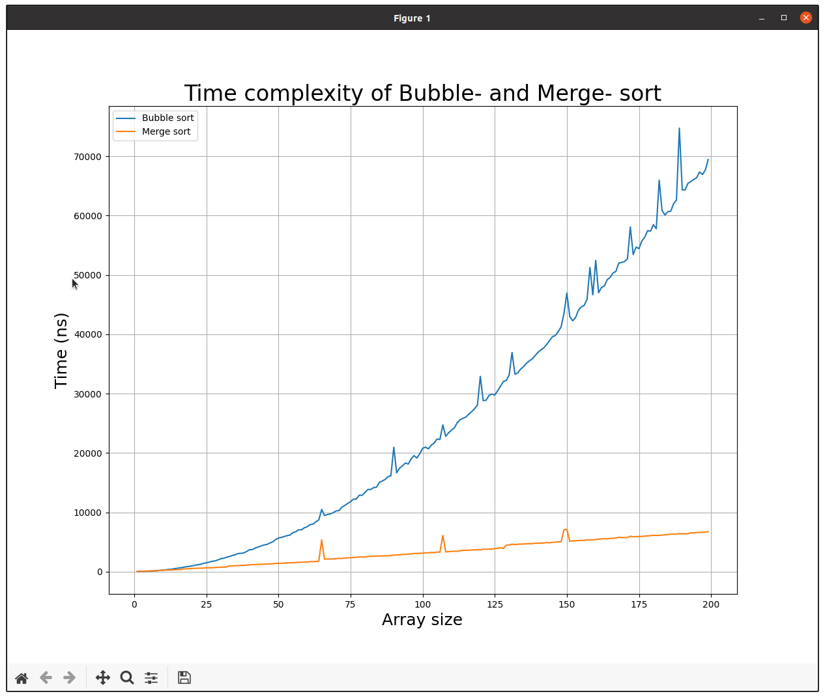
Hopefully, what you see looks like that…

Slide 22
Bubbles and Complexity
In short, Bubble-sort looks like this:
swapped = True, j = 1 while swapped: for i = 0,1,..., n - j: if arr[i] > arr[i + 1]: swap arr[i] and arr[i + 1] swapped = True j++; arr has been sorted!
What about (worst-case) complexity?

Slide 23
Bubbles and Complexity
In short, Bubble-sort looks like this:
swapped = True, j = 1 while swapped: ← This will be executed at most n-1 times for i = 0,1,..., n - j: ← This is roughly n iterations if arr[i] > arr[i + 1]: swap arr[i] and arr[i + 1] swapped = True j++; arr has been sorted!
Worst case complexity: O(n x (n-1)) = O(n^2)
Elementary Operation

Slide 24
Merging and Complexity
In short, Merge-sort looks like this:
n = len(arr) for i = 0, 1, …, log(len(arr)): for j = 0, 1, …, n: left = arr[j : j+2^i] right = arr[j+2^i : j+2^(i+1)] merge(left, right) n = n / 2
arr has been sorted!
What about (worst-case) complexity?

Slide 25
Merging and Complexity
In short, Merge-sort looks like this:
n = len(arr) for i = 0, 1, …, log(len(arr)): ← This is repeated log(n) times for j = 0, 1, …, n: ← Don’t fall for this! left = arr[j : j+2^i] right = arr[j+2^i : j+2^(i+1)] merge(left, right) ← len(left) + len(right) EO n = n / 2 which means n EO per iteration.
arr has been sorted!
Worst case complexity: O(nlog(n))

Slide 26
Why merge log(n) times?
Consider a list of length 8 = 2^3 (just for convenience). Once broken into pieces of length == 1, you have 8 tiny lists of one element each.
Every time you merge you are left with exactly half (±1) tiny lists (of roughly double size)
So, after how many “merge runs” will you be left with just one (the initial) list?
8 tiny lists → 4 tiny lists → 2 tiny lists → 1 large list.
At each step you divide by two, so, essentially, you are looking for the number of consecutive divisions by 2 required to reach 1, starting from 8.
Reading this right to left, we can count the number of multiplications by 2 required to reach 8 from 1, i.e., if m is that number, we want an m such that: 2^m == 8.
This is exactly the definition of log(8) (log = logarithm base 2)
Substitute 8 with n and you get (roughly) m = log(n).

Slide 27
Insertion Sort
Consider the following sorting algorithm:
i = 1 while i < len(arr): j = i while j > 0 and arr[j] < arr[j - 1]: swap arr[j] and arr[j-1] j-- i++
arr has been sorted!
What about worst-case complexity?

Slide 28
Insertion Sort
Consider the following sorting algorithm:
i = 1 while i < len(arr): ← This is repeated n times j = i while j > 0 and arr[j] < arr[j - 1]: ← At most n - 1 times swap arr[j] and arr[j-1] j-- i++
arr has been sorted!
Worst-case complexity: O(n x (n-1)) = O(n^2)

Slide 29
Bogus – Bogus
Consider the following sorting algorithm:
while arr is not sorted: randomly shuffle arr return arr
arr is sorted!
What about worst-case time complexity?

Slide 30
Bogus – Bogus
Consider the following sorting algorithm:
while arr is not sorted: ← There are n! different permutations randomly shuffle arr ← Each shuffling takes roughly O(n) return arr
arr is sorted!
In the worst case, arr will never be shuffled correctly, so infinite time!
On average, O((n-1)n!) (n! = 1·2·3·…·n), so, much (much) slower than everything we have seen so far!

Slide 31
Homework 1
Look at the animated image on the right. You can observe, in action, a sorting algorithm called Quicksort.
Using only the image and nothing else (no internet, no books, no LLMs, no entity that can somehow help you) try to describe the algorithm in plain english and / or pseudocode.
Look around the web / books for Quicksort. How accurate is your description?
Implement Quicksort using python and test it on some lists of numbers.
Share your responses at: v.markos@mc-class.gr
Image Source: https://en.wikipedia.org/wiki/Quicksort (do not open this!)

Slide 32
Fun Time!

Slide 33
Booker Paige, Again
Open this week’s tutorial found at ‘./Labs/tutorial_01.pdf’.
Follow the instructions therein.
In case you have not completed your database design / normalisation from last week’s tutorial, do it now!
Have Fun!

Slide 34

Any Questions?
Don’t forget to fill-in the questionnaire! (check right)
https://forms.gle/zezKMVzhaT4xyJgk8

